Slide 1
Murder On The Orient Express
Presented by :
AMIT ROY (2017-3-60-021)
MD. Mokibul hasan Antor (2017-3-60-019)
shekhor chandra saha (2017-3-60-025)

Slide 2
Overview
Problem Statement
Algorithm
Implementation
Testing
Limitation

Slide 3
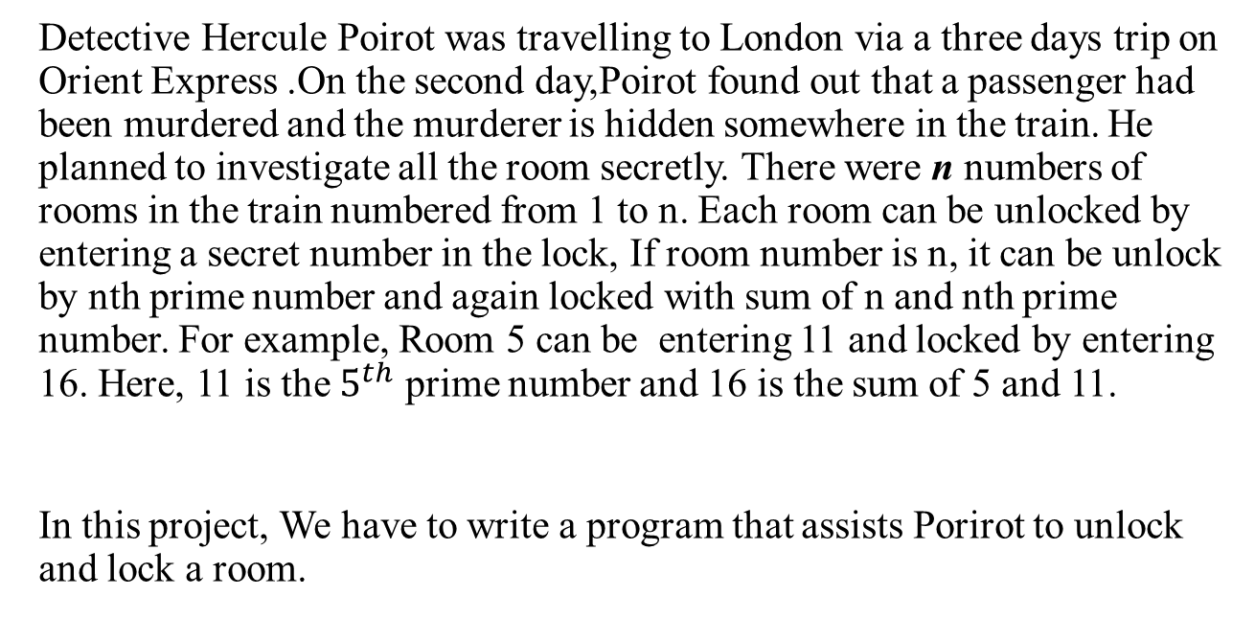
Problem Statement
Detective Hercule Poirot was travelling to London via a three days trip on Orient Express .On the second day,Poirot found out that a passenger had been murdered and the murderer is hidden somewhere in the train. He planned to investigate all the room secretly. There were n numbers of rooms in the train numbered from 1 to n. Each room can be unlocked by entering a secret number in the lock, If room number is n, it can be unlock by nth prime number and again locked with sum of n and nth prime number. For example, Room 5 can be entering 11 and locked by entering 16. Here, 11 is the $5^{th}$ prime number and 16 is the sum of 5 and 11.
In this project, We have to write a program that assists Porirot to unlock and lock a room.

Slide 4
Algorithm
1. Send a input in void function from main function
2. Play a infinity loop.
2.1: Scan a number as input.
3. If number is not equal to 0
3.1: If numbem(num) is less then equal 100
3.1.1: Loop from i=2 to less then equal 10000
3.1.1.1: If count not equal to num
3.1.1.1.1: Play a loop from j=2 to less then equal j
3.1.1.1.1.1: If i and j are equal

Slide 5
Algorithm
3.1.1.1.1.1.1: Add 1 to Count and store it in count.
3.1.1.1.1.1.2: Srore i in un.
3.1.1.1.1.2: If else i mod j equal to 0
3.1.1.1.1.2.1: Break.
3.1.2: Count equal to 0
3.1.3: Print Unlock with: (Value of un)
3.1.4: Print Lock with: (Sum of num and un)
3.2: Else
3.2.1: Print Room does not exist.
4. Else
4.1: Break.

Slide 6
Implementation
Main Function:
int main()
{
int input;
printf("\t\t\tMURDER ON THE ORIENT EXPRESS\n");
printf("-----------------------------------------------------------------------\n");
function(input); //Send input in a function
return 0;
}

Slide 7
Implementation
Taking Input:
void function(x) //Receive input in void type function
{
int num,i,j,un,count=0; //Declare integer
for( ; ; ) //Infinity Loop
{
printf("Enter Room Number: ");
scanf("%d",&num); //Take a number as a input
printf("\n");

Slide 8
Implementation
Condition :
if(i==j) // If condition
{
count=count+1; // Counter
un=i; //Store i in un.
}
else if(i%j==0)
{
break; //Break statement
}

Slide 9
Implementation
Print:
printf("Unlock with: %d",un); //Print un .
printf("\t\t\tLock with: %d\n",num+un); //Print sum of num and un.

Slide 10
Testing
Testcase 1:

Slide 11
Testing
Testcase 2:

Slide 12
Testing
Testcase 3:

Slide 13
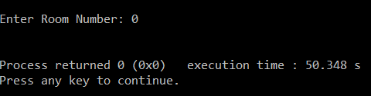
Testing
Testcase 4:

Slide 14
Limitations
Our program is unable to check whether the input is empty or not.
Our program is unable to check uppercase and lowercase characters or symbols.
Our program is unable to check negatives inputs .

Slide 15
Thank You

